Slide 1
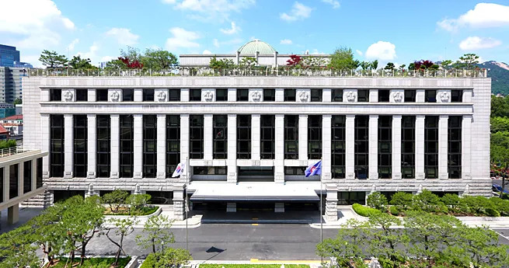
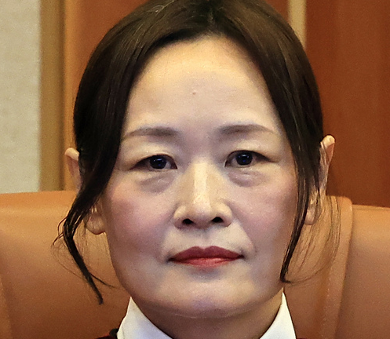
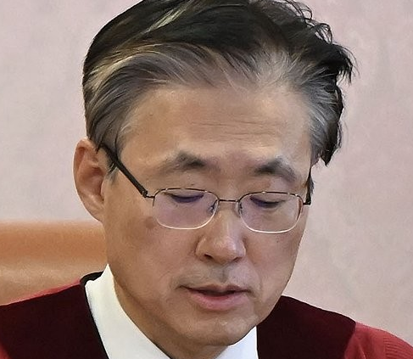
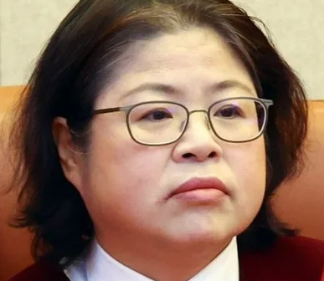
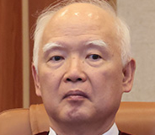
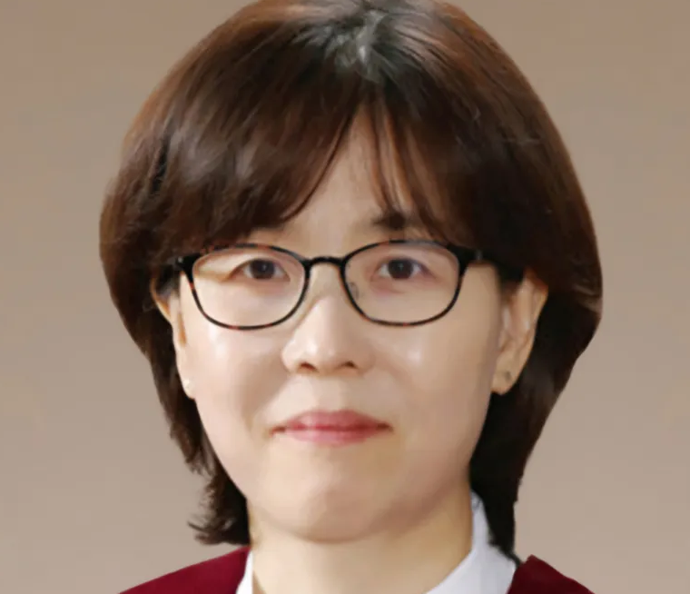



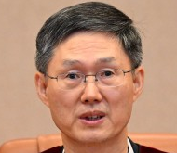
Mison Lee
~ 04.18.2025
Jungmi Jung
~ 04.16.2029
Hyungdu Kim
~ 03.30.2029
Bok-hyeong Kim
~ 09.20.2030
Hyeong-sik Jeong
~ 12.17.2029
Supreme Court
President
National Assembly
Hyoungbae Moon
~ 04.18.2025

Slide 2
Mison Lee
~ 04.18.2025
Jungmi Jung
~ 04.16.2029
Hyungdu Kim
~ 03.30.2029
Bok-hyeong Kim
~ 09.20.2030
Hyeong-sik Jeong
~ 12.17.2029
Supreme Court
President
National Assembly
Hyoungbae Moon
~ 04.18.2025

